Slide 1
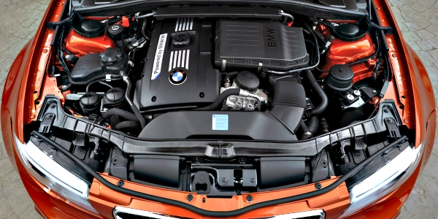

Angular Under the Hood
Marko Stanimirović

Slide 2







Marko Stanimirović
Software Developer
Angular Belgrade Organizer
OSS Contributor
Hobby Musician
MSc in Software Engineering
@MarkoStDev
markostanimirovic

Slide 3
Contents
Compilation
Zone.js
Change Detection
Zone-Less Applications

Slide 4
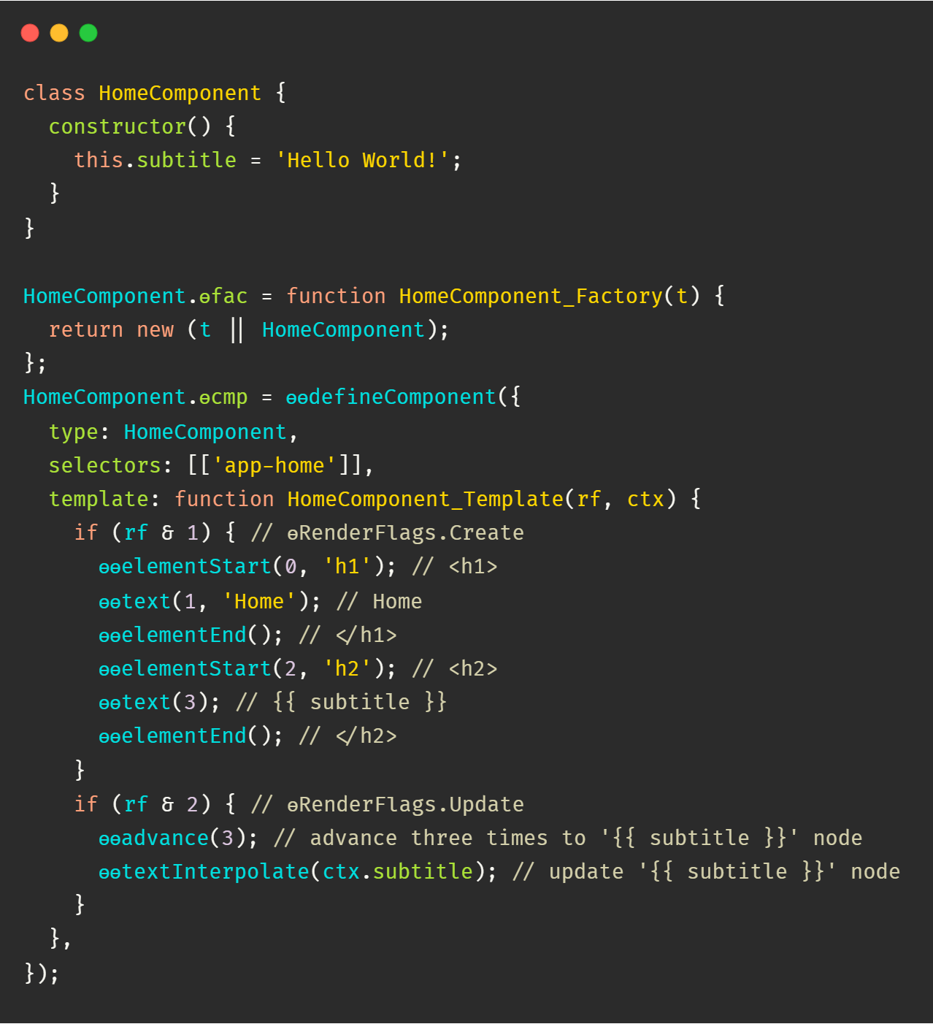
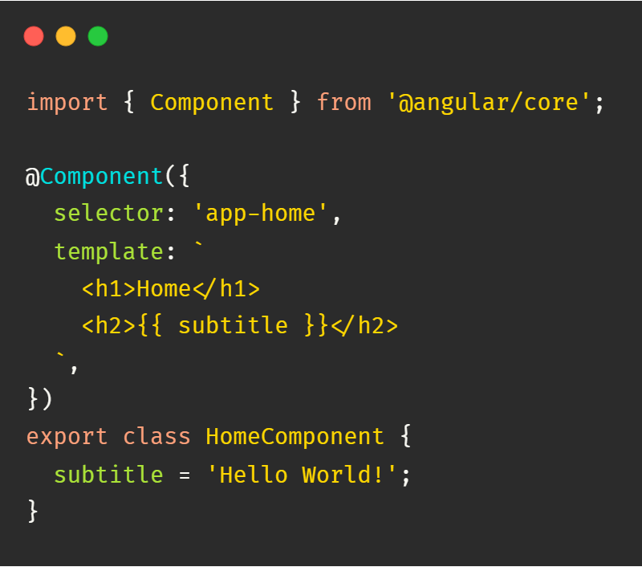
Compilation
ng build

Slide 5
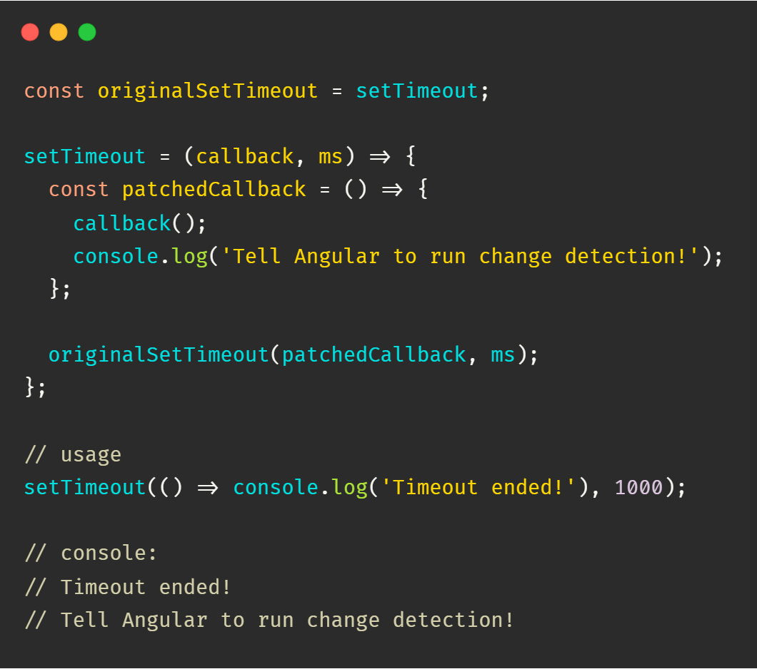
Zone.js
Executed before the Angular application is bootstrapped
Tells Angular when to run the change detection mechanism
Monkey patches browser APIs

Slide 6
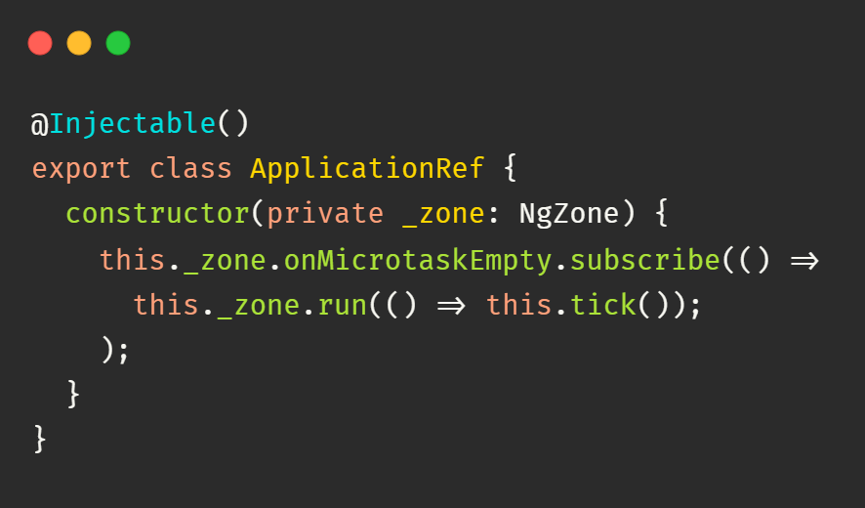
Change Detection
Application Ref
App Component
Child Component 2
Child Component 1
Child Component 1.1
Child Component 1.2

Slide 7
Zone.js Downsides
Not tree shakable (uncompressed size >100kB)
Slower application bootstrap speed
Unnecessary change detection triggering
Magic
Cannot monkey patch native async/await (ES2017)

Slide 8
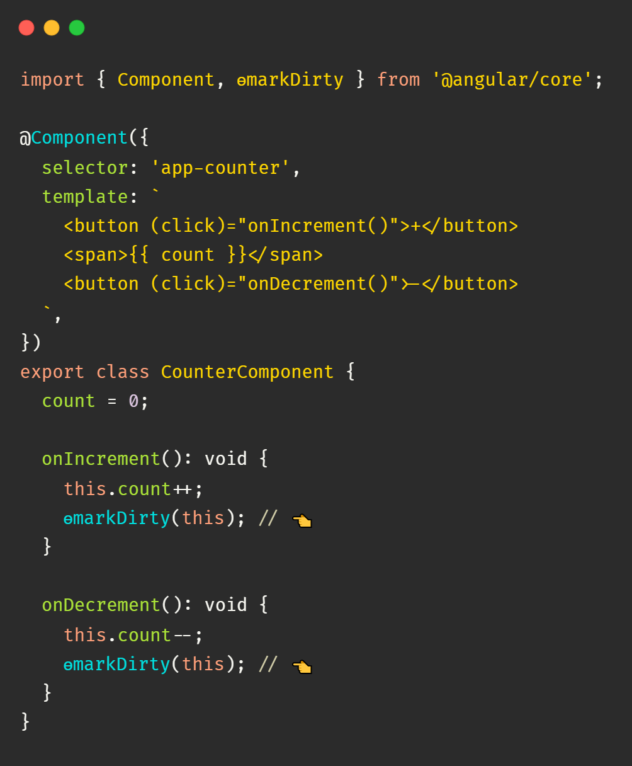
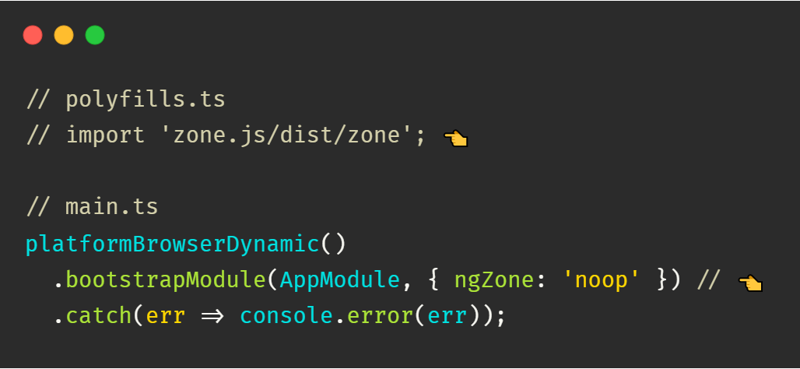
Zone-Less Applications
Trigger change detection only when necessary

Slide 9
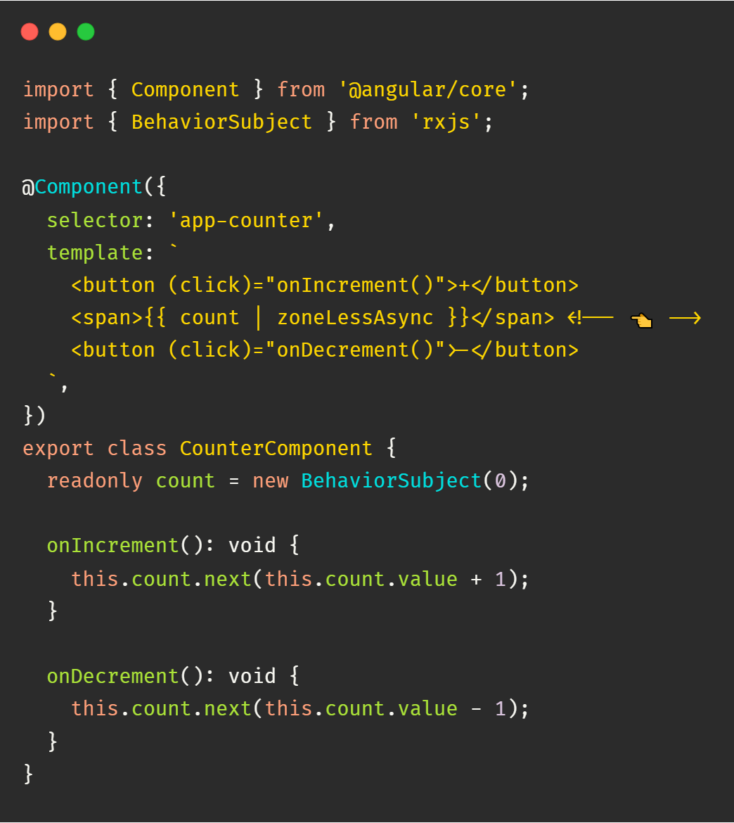

How to trigger change detection automatically?

Slide 10
Demo

Slide 11
Thank you!

